Slide 1
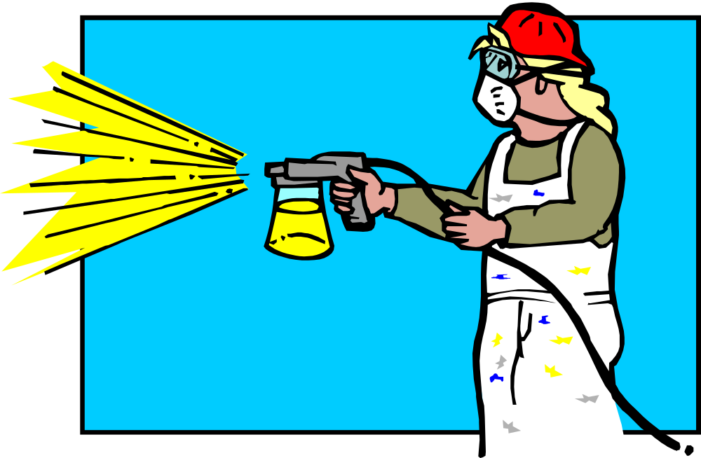
Subpart I
Personal Protective
Equipment
1910.132-138

Slide 2
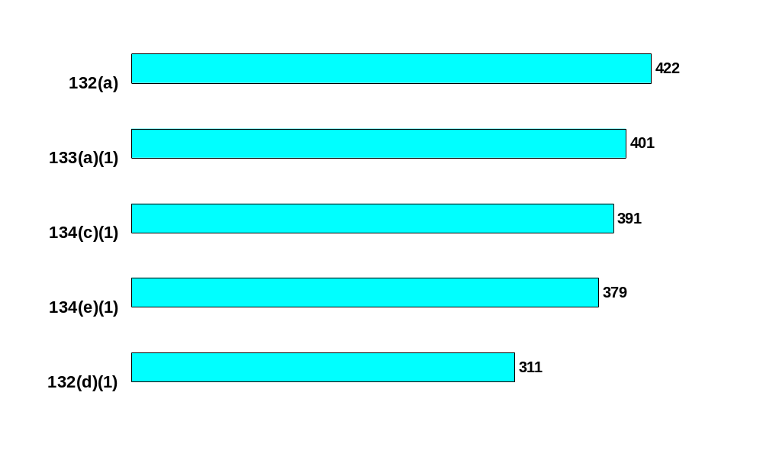

Subpart I - Personal Protective Equipment (1910.132 - 139)
Personal protective equipment
*
Eye & face protection
*
Written respiratory protection program
*
Standard: 1910.
Medical evaluation to determine employee’s ability to use respirator
*
PPE hazard assessment
*
*Average number of Federal OSHA citations issued
between 2000 and 2003

Slide 3
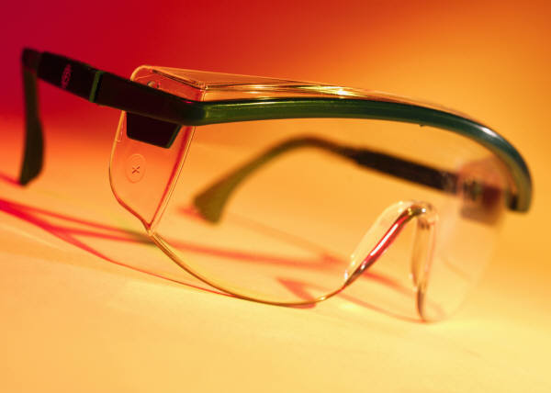
1910.132 General Requirements
(a)Protective equipment, including personal protective equipment for:
  Eyes,
  Face,
  Head, and extremities,
  Protective clothing,
  Respiratory devices, and
  Protective shields and barriers,
Shall be provided, used, and maintained in a sanitary and reliable condition wherever it is necessary by reason of hazards of processes or environment

Slide 4

1910.132 General Requirements
(a) Includes:
  Chemical hazards,
  Radiological hazards, or
  Mechanical irritants
Encountered in a manner capable of causing injury or impairment in the function of any part of the body through absorption, inhalation or physical contact.

Slide 5
Standard Interpretations
05/29/1997 - A hazardous chemical is any chemical which is a physical hazard or a health standard
In 29 CFR 1910.1200, OSHA simply states a hazardous chemical is any chemical which is a physical hazard or a health hazard.
Antifreeze, oil and diesel are at the minimum irritants and, as such, would all fall under the category of "hazardous chemical.”
Cotton uniforms should not be regarded as personal protective equipment (PPE) in this case. If chemical splashes are expected, then impermeable clothing should be worn.

Slide 6
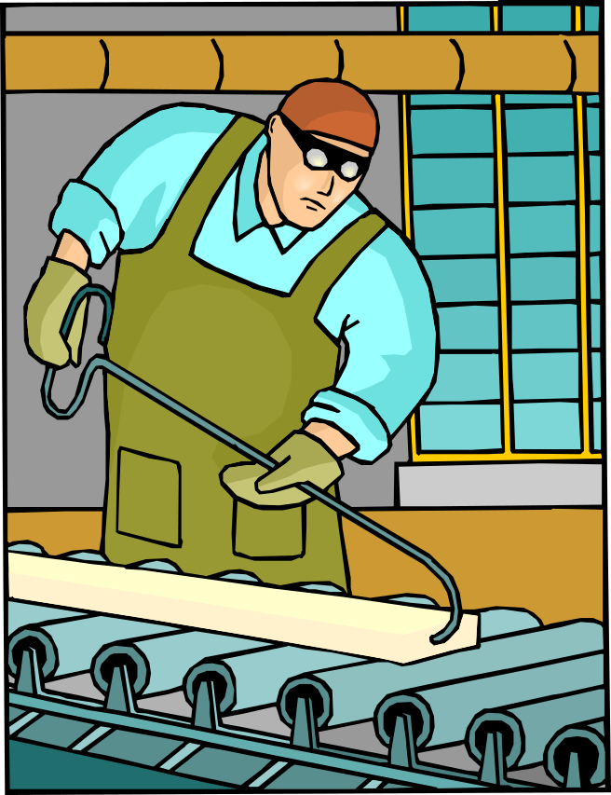
1910.132(b) Employee Owned Equipment
Where employees provide their own protective equipment, the employer shall be responsible to assure its adequacy, including proper maintenance, and sanitation of such equipment.

Slide 7
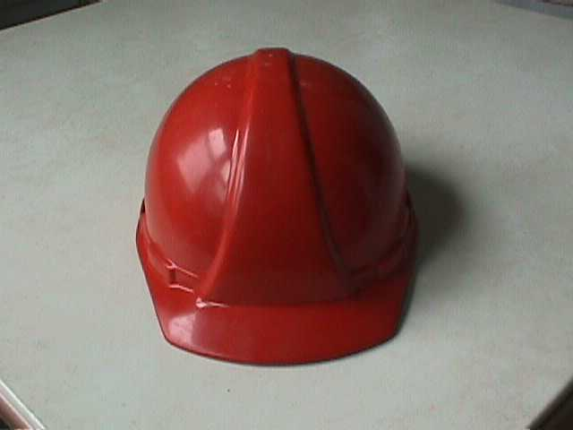
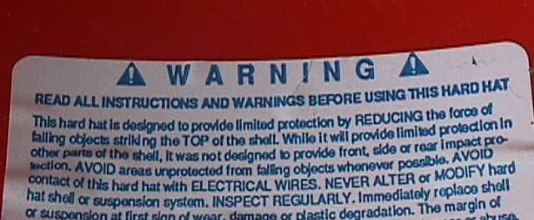
1910.132(c) Design
All personal protective equipment shall be of safe design and construction for the work to be performed.

Slide 8

1910.132(d) Hazard Assessment
(1)The employer shall assess the workplace to determine if hazards are present which necessitate the use of personal protective equipment (PPE)
If hazards are present the employer shall:
  (i)Select, and have each affected employee use, the types of PPE that will protect the affected employee from the hazards identified in the hazard assessment;

Slide 9
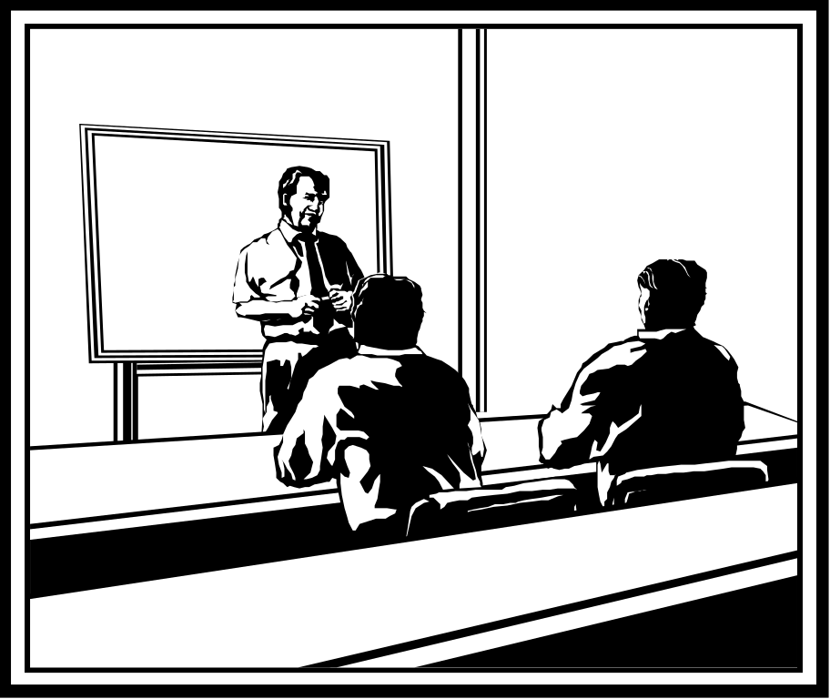
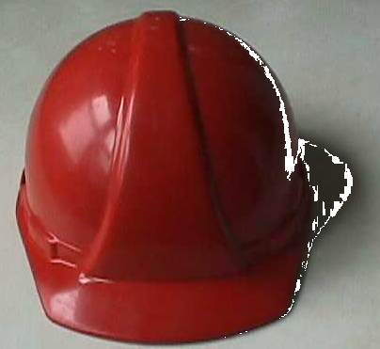
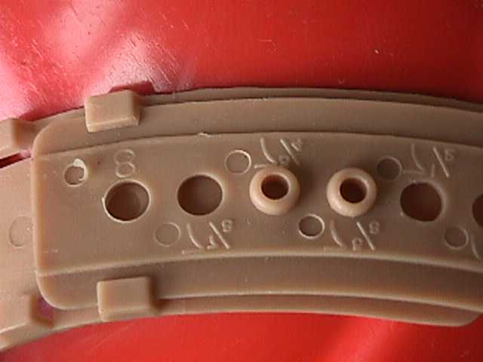
1910.132(d) Hazard Assessment
(1)(ii)Communicate selection decisions to each affected employee; and,
(1)(iii)Select PPE that properly fits each affected employee
PPE

Slide 10

1910.132(d) Hazard Assessment
(2)The employer shall verify that the required workplace hazard assessment has been performed through a written certification that identifies:
  The workplace evaluated;
  The person certifying that the evaluation has been performed;
  The date(s) of the hazard assessment; and,
  Which identifies the document as a certification of hazard assessment
Hazard
Assessment
XYZ Inc.

Slide 11
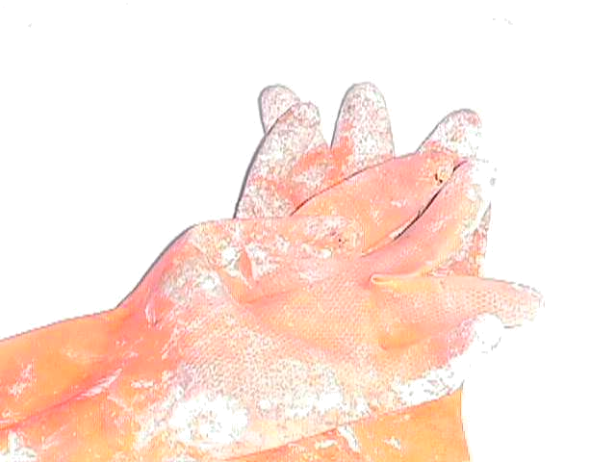
1910.132(e) Defective and damaged equipment
Defective or damaged personal protective equipment shall not be used.

Slide 12

1910.132(f) Training
(1)The employer must train employees before issuing PPE
Each employee trained to know at least the following:
  (i)When PPE is necessary;
  (ii)What PPE is necessary;
  (iii)How to properly don, doff, adjust, and wear PPE;
  (iv)The limitations of the PPE; and,
  (v)The proper care, maintenance, useful life and disposal of the PPE.
PPE

Slide 13

1910.132(f) Training
(2)Workers must demonstrate an understanding of the training and the ability to use PPE properly, before being allowed to perform work requiring the use of PPE:
  (4)Verify that each employee has received and understood the required training through a written certification that contains:
    The name of each employee trained,
    The date(s) of training, and that
    Identifies the subject of the certification
Certificate
of Training

Slide 14

1910.132(f)(3) Retraining
When any employee who has already been trained does not have the understanding and skill required he shall retrain each such employee
Circumstances where retraining is required include, but are not limited to, situations where:
  Changes in the workplace or the PPE used render previous training obsolete
  Inadequacies in an affected employee's knowledge or use of assigned PPE
PPE
Refresher

Slide 15

1910.133 Eye and face protection
(a)(1)Ensure that each affected employee uses appropriate eye or face protection when exposed to eye or face hazards from:
  Flying particles,
  Molten metal,
  Liquid chemicals, acids or caustic liquids,
  Chemical gases or vapors, or potentially injurious light radiation

Slide 16
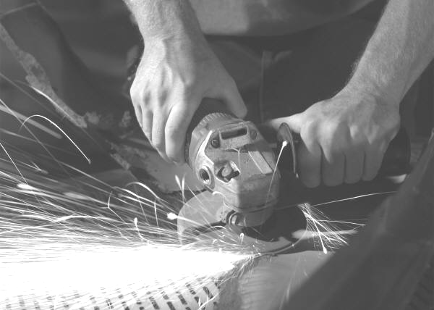
1910.133 Eye and face protection
(a)(2)Ensure that each affected employee uses eye protection that provides side protection when there is a hazard from flying objects*
*Detachable side protectors (e.g. clip-on or slide-on side shields) meeting the pertinent requirements of this section are acceptable.

Slide 17

1910.133 Eye and face protection
(a)(3)Ensure that each employee who wears prescription lenses while engaged in operations that involve eye hazards
  Wears eye protection that incorporates the prescription in its design, or
  Wears eye protection that can be worn over the prescription lenses
  Without disturbing the proper position of the prescription lenses or the protective lenses

Slide 18

1910.133 Eye and face protection
(a)(5)The employer shall ensure that each affected employee uses equipment with filter lenses that have a shade number appropriate for the work being performed for protection from injurious light radiation

Slide 19
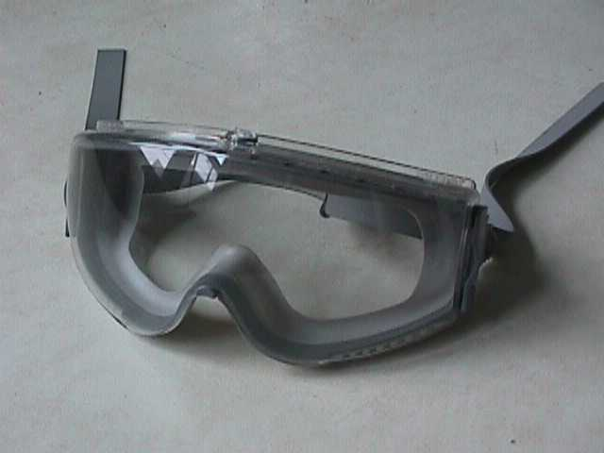
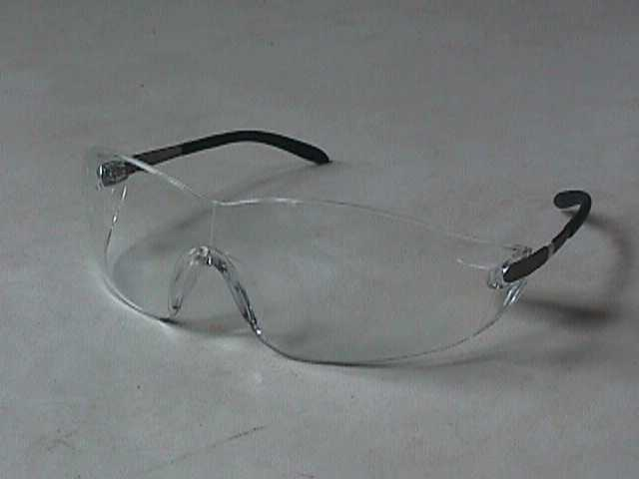
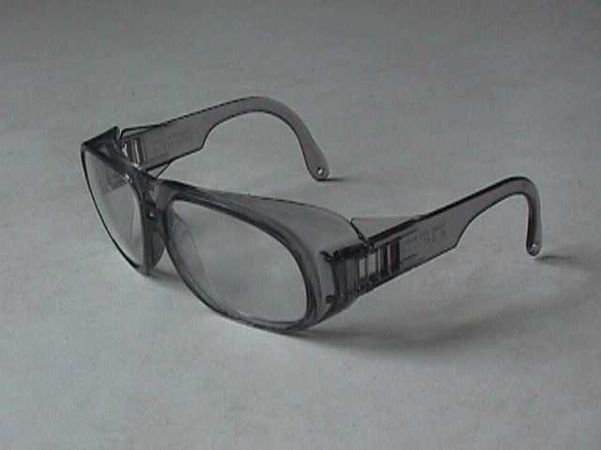
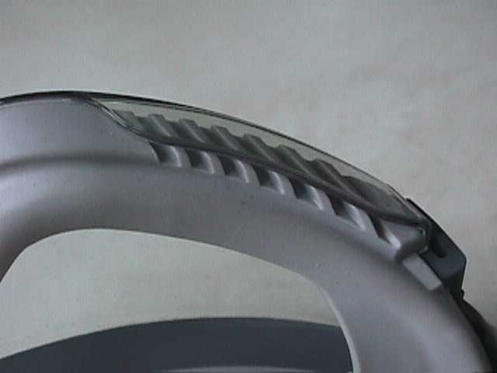
Protective eye and face devices purchased after July 5, 1994 shall comply with ANSI Z87.1-1989
Z 87.1-1989

Slide 20


CFR 1910.134
Respiratory Protection

Slide 21

1910.134(a) Permissible practice
1st Priority: Engineering controls:
  Enclosure or confinement of the operation,
  General and local ventilation, and
  Substitution of less toxic materials
Only where engineering controls are not feasible should respirators be used

Slide 22

1910.134(a)(2) Employers responsibilities
Respirators:
  Provided by the employer
  Must provide the respirators which are applicable and suitable for the purpose intended
  The employer is responsible for the establishment and maintenance of a respiratory protection program

Slide 23

1910.134(c) Respiratory protection program
Requires worksite-specific procedures and elements for required respirator use
The program must be administered by a suitably trained program administrator*
Respiratory Protection:
Issues & Answers
*The Small Entity Compliance Guide contains criteria for the selection of a program administrator and a sample program that meets the requirements of this paragraph. Copies of the Small Entity Compliance Guide are available from the OSHA Office of Publications, Room N 3101, 200 Constitution Avenue, NW, Washington, DC, 20210 (202-219-4667).

Slide 24
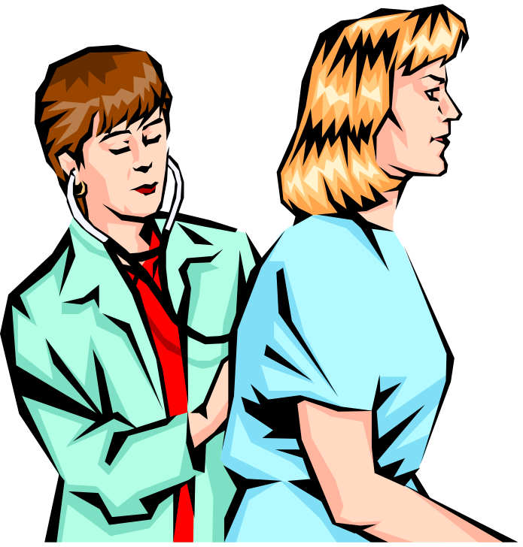
1910.134(c) Respiratory protection program
Where respirators are necessary:
  Written program
  Worksite-specific procedures
  Required elements:
    Training
    Fit testing
    Medical evaluations
    Procedures for respirator selection
    Procedures for routine & emergency use

Slide 25
1910.134(c)(2) Where respirator use is not required:
  If voluntary respirator use is permissible, provide the respirator users with the information contained in Appendix D and,
  Establish and implement those elements of a written respiratory protection program* necessary to ensure that any employee using a respirator voluntarily is medically able to use that respirator
  That the respirator is cleaned, stored, and maintained so that its use does not present a health hazard to the user
*Written program not required for voluntary use of dust masks

Slide 26

Appendix D Highlights
If your employer provides respirators for your voluntary use, of if you provide your own respirator, you need to take certain precautions to be sure that the respirator itself does not present a hazard:
  Read all instructions
  Choose certified respirators
  Understand its application and limitations
  Don’t mix it up with someone else’s

Slide 27

1910.134(e) Medical evaluations
Medical evaluations provided before:
  Fit testing
  Worker respirator use
Identify a physician or other licensed health care professional (PLHCP) to perform medical evaluations using a medical questionnaire:
  Obtain the information requested by the questionnaire in Sections 1 and 2, Part A of Appendix C

Slide 28

1910.134(e)(6) Medical determination
Obtain a written recommendation regarding the employee's ability to use the respirator
The recommendation shall provide only the following information:
  Whether or not the employee is medically able to use the respirator;
  Any limitations on respirator use related to the medical condition of the employee
  The need, if any, for follow-up medical evaluations
  A statement that the PLHCP has provided the employee with a copy of the PLHCP's written recommendation

Slide 29

Head Protection
CFR 1910.135

Slide 30

1910.135(a) General requirements
(1) Ensure that each employee wears a protective helmet when working in areas where there is a potential for injury to the head from falling objects

Slide 31

Classes and types of Hard hats
Type I hard hats - intended to reduce the force of impact resulting from a blow to the top of the head
Type II hard hats - designed to provide protection against both side impact (lateral) and blows to the top of the head
Classes
G (old A)
General
2,200 volts
E (old B)
Electrical
20,000 volts
C (same)
Conductive

Slide 32
Standard Interpretations
08/23/1983 - Clarification on standards for head protection
The employer must determine which employees are exposed to possible head injury hazards, and assure that they wear appropriate head protection.
Where employees are not exposed to possible head injuries, head protection is not required by OSHA standards.
An employer may choose to require the wearing of head protection by certain employees or in certain activities at all times as a precautionary measure, although this may be a matter subject to labor/management negotiation.

Slide 33
Standard Interpretations
08/23/1983 - Clarification on standards for head protection
OSHA has no exhaustive guidelines for determining whether head protection is required, this must be done on a case-by-case basis, depending on:
  The specific operation,
  Worksite,
  Potential hazards, and other circumstances.

Slide 34
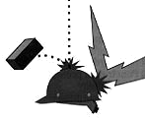
1910.135(a) General requirements
The employer shall ensure that a protective helmet designed to reduce electrical shock hazard is worn by each such affected employee when near exposed electrical conductors which could contact the head

Slide 35
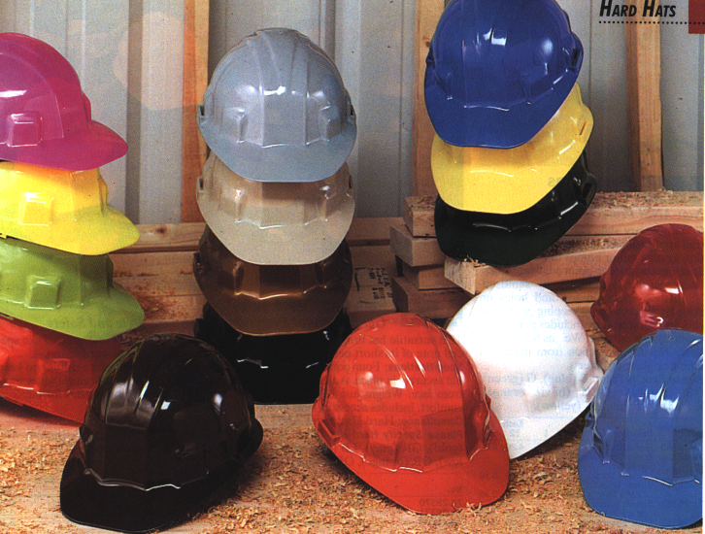
1910.135(b) Criteria for protective helmets
Protective helmets purchased after July 5, 1994 shall comply with ANSI Z89.1-1986

Slide 36
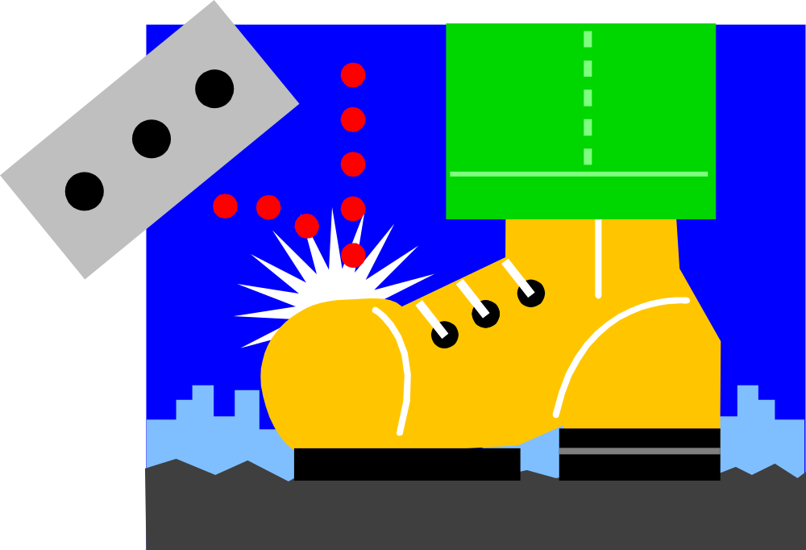
Foot Protection
CFR 1910.136

Slide 37

1910.136(a) General requirements
Ensure that each affected employee uses protective footwear when working in areas where there is:
  A danger of foot injuries due to falling or rolling objects, or
  Objects piercing the sole, and
  Where such employee's feet are exposed to electrical hazards

Slide 38
Standard Interpretations
09/20/1993 - Personal protective equipment, general requirements and employer responsibility
The current standard does not state that the employer must purchase and distribute protective footwear "...with no cost to the employee".
This question has been raised several times since the inception of OSHA, and it has normally been considered a labor/management relations matter, resolved through formal or informal negotiations between the affected parties.

Slide 39

1910.136(b) Criteria for protective footwear
Protective footwear purchased after July 5, 1994 shall comply with ANSI Z41-1991, "American National Standard for Personal Protection-Protective Footwear,"

Slide 40

Hand Protection
CFR 1910.138

Slide 41

1910.138(a) General requirements
Employers shall select and require employees to use appropriate hand protection when employees' hands are exposed to hazards such as those from:
  Skin absorption of harmful substances;
  Severe cuts or lacerations;
  Severe abrasions;
  Punctures;
  Chemical burns;
  Thermal burns; and
  Harmful temperature extremes

Slide 42

1910.138(b) Selection
Employers shall base the selection of the appropriate hand protection on:
  An evaluation of the performance characteristics of the hand protection relative to the task(s) to be performed,
  Conditions present,
  Duration of use, and
  The hazards and potential hazards identified

Slide 43
The End

